Slide 1



Garbage Classification

Slide 2

Learning Objectives
1. Understand Image Classification for Real-World Problems
Learn how to apply deep learning to a practical and socially relevant task:
classifying types of trash.
Explore how AI can assist in automated waste management and recycling.
2. Hands-On with Image Dataset Preparation
Learn how to load, split, and preprocess image datasets using TensorFlow.
Visualize and analyze dataset distribution for training, validation, and testing.
3.Apply Transfer Learning using MobileNetV3
Understand the concept of transfer learning and how to fine-tune pretrained
models like MobileNetV3Large.
Freeze and unfreeze layers strategically to balance speed and accuracy
GOAL
Source :
www.freepik.com/

Slide 3
4.Handle Class Imbalance using Class Weights
Compute and apply class weights to improve model performance on underrepresented classes.
5. Train and Evaluate Deep Learning Models
Implement data augmentation techniques to improve generalization.
Monitor training using validation accuracy/loss.
Apply early stopping to avoid overfitting.
6. Model Evaluation using Confusion Matrix & Metrics
Evaluate model predictions using accuracy, precision, recall, and F1-score.
Visualize confusion matrix and analyze model strengths/weaknesses.
7.Build an End-to-End AI Pipeline
Combine preprocessing, training, validation, evaluation, and deployment in one streamlined workflow
8. Deploy Image Classifier with Gradio Interface
Create an interactive user interface using Gradio to classify trash images in real-time.
Understand how to convert trained models into usable applications.
9.Model saving
learn how to save and load trained models(.keras)for future inference or deployment

Slide 4
Tools and Technology used
Programming Language & Libraries
Python – Core language for development
NumPy – Numerical computations
Matplotlib & Seaborn – Data visualization
Scikit-learn – Evaluation metrics & class weight computation
Deep Learning & Model Building:
TensorFlow & Keras – Model creation, training, evaluation
MobileNetV3Large-Pretrained CNN used for transfer learning
Data Augumentation-Applied Using Keras layers(RandomFlip,Rotation,etc)
EarlyStopping-keras callback to prevent ovetfitting

Slide 5
Dataset Handling & Preprocessing:
TensorFlow image_dataset_from_directory – Efficient image loading
Class Weight balancing-Using compute_class_weight() to handle imbalance
Evaluation and visualization:
Confusion matrix and classification report-from sklearn.metrics
Training and visualization-Accuracy and loss curves using matplotlib
Gradio-Web based UI for real-time image classification
Keras -.keras format for model persistence

Slide 6
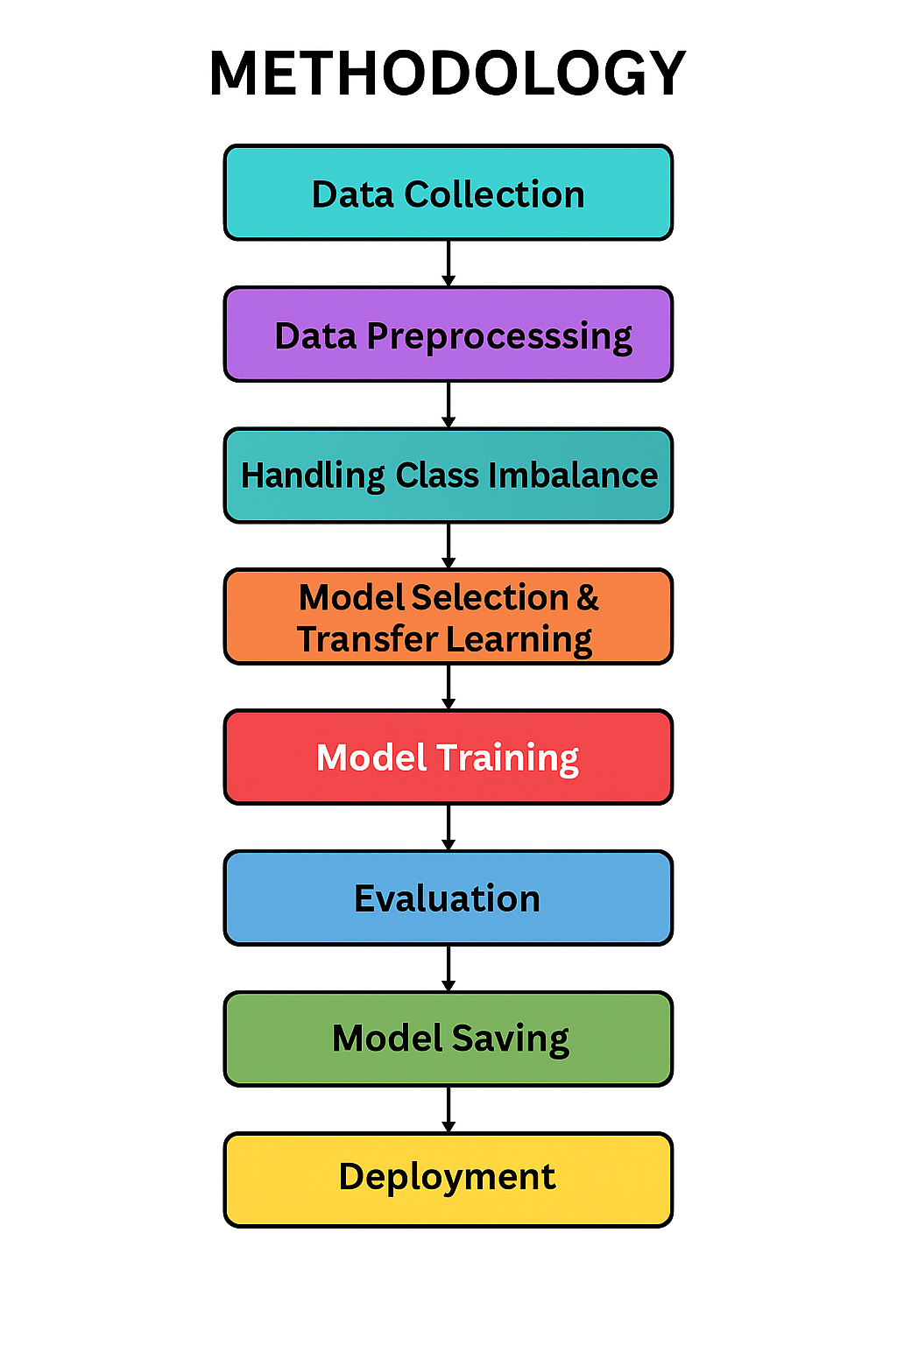
Methodology
1. Data Collection: Collected trash images from a labeled dataset with multiple waste categories.
2. Data Preprocessing: Resized images to 124x124, normalized pixel values, and applied data augmentation techniques.
3. Class Imbalance Handling: Computed class weights to ensure balanced learning for underrepresented classes.
4. Model Selection: Used MobileNetV3Large with transfer learning to leverage pretrained knowledge.
5. Model Training: Trained with Adam optimizer, early stopping, and monitored validation loss.
6. Model Evaluation: Measured performance using accuracy, confusion matrix, and classification report.
7. Model Saving: Saved the trained model in .keras format for future inference.
8. Deployment: Built an interactive web interface using Gradio for real-time image classification.

Slide 7
Problem Statement:
In this project, we aim to develop a sophisticated garbage classification system leveraging the MobileNetV3Large architecture. Our primary dataset serves as a foundation for building models that can eventually automate waste segregation, a critical step in optimizing recycling and waste management, ultimately aiding in environmental conservation.
Explanation:
1. Importance of Garbage Classification: Manual waste segregation is time-consuming and inefficient. Automating it helps improve recycling and reduce environmental impact.
2. Why MobileNetV3Large?: It is a lightweight, high-performance model suitable for real-time image classification using transfer learning.
3. Role of Dataset: The labeled garbage image dataset enables the model to learn and distinguish between different waste types.
4. Real-World Impact: Can be used in smart bins, municipal waste systems, and recycling plants to support sustainable waste management.
5. Summary: The project uses deep learning to build an efficient system for automatic waste classification, contributing to environmental conservation.

Slide 8
Solution:
The proposed solution involves designing an AI-based garbage classification system using MobileNetV3Large.
A pre-trained MobileNetV3Large model is fine-tuned on a labeled dataset of waste images.
The model learns to classify different garbage categories such as plastic, paper, metal, and more.
Data augmentation and class balancing are used to improve model robustness.
Early stopping and validation monitoring help avoid overfitting.Once trained, the model is deployed using Gradio to allow users to upload images and receive real-time predictions.
This solution contributes to automating waste segregation, which supports better recycling practices and environmental sustainability.

Slide 9
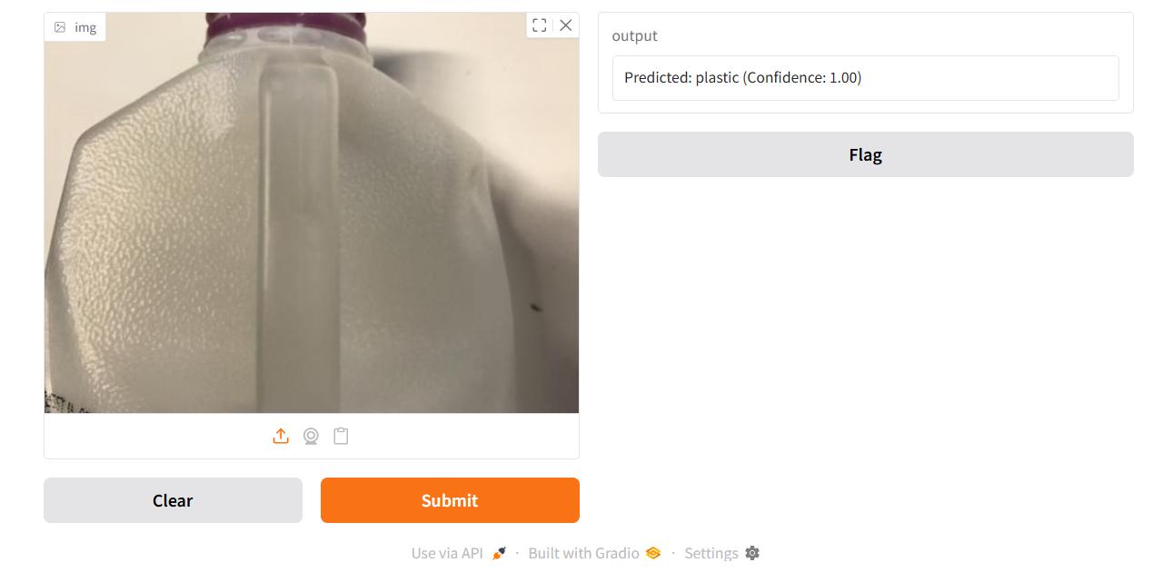
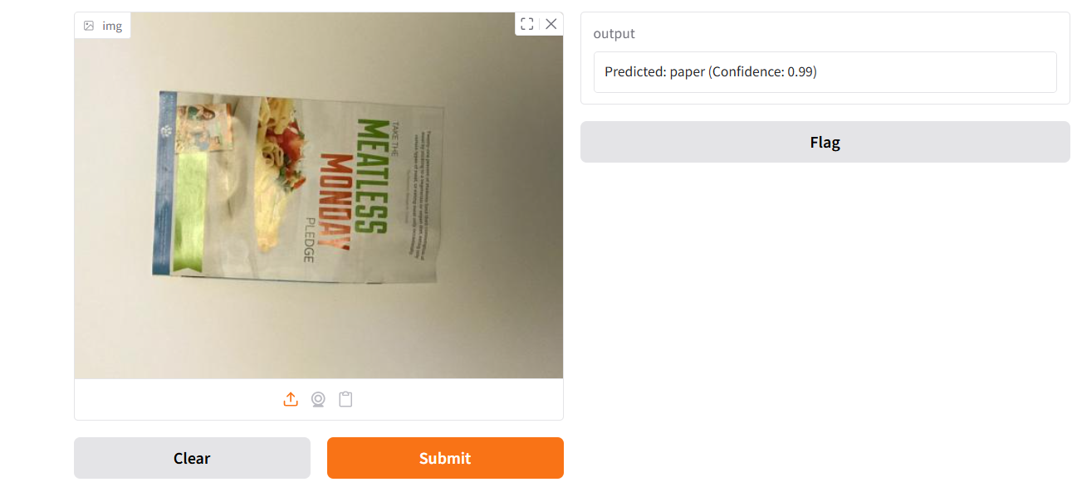
Screenshot of Output:
When we upload image of any garbage then our model will predict what type of classification it is as shown in above screenshots

Slide 10
Conclusion:
The image classification model demonstrates strong accuracy in identifying objects, leveraging deep learning to refine predictions effectively. Its robust performance ensures reliable classification, making it a valuable tool for various applications.

